Slide 1
Internet History

Slide 2

HyperText System

Slide 3
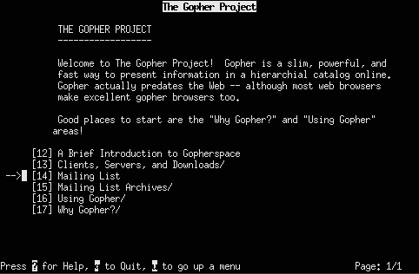
Gopher

Slide 4
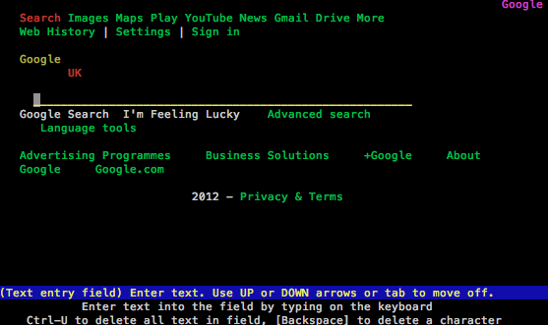
Lynx

Slide 5
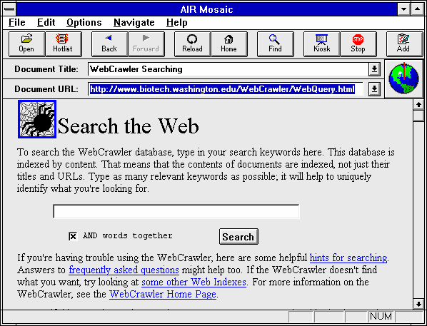
Mosaic

Slide 6
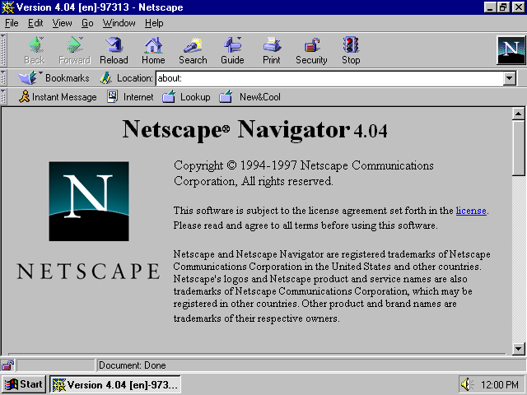
Netscape

Slide 7
Web Servers

Slide 8
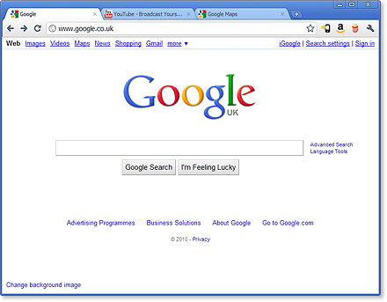

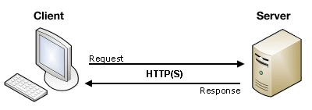
Client / Server
Web server
Web browser Client

Slide 9

Web Hosting
Running a web server on your home computer.
Web Server (such as Apache)
Requires DMZ or Port Forwarding.
Some providers block port 80
Using a hosting site. They have a high speed connection. And maintain the server.

Slide 10


Domain Name Registration
You need a registrar to manage your domain name registration.
Do private registration to keep your email, phone, and mailing address private.
You need to provide a Name Server (NS) for your domain. Typically your host will tell you which NS to use.

Slide 11
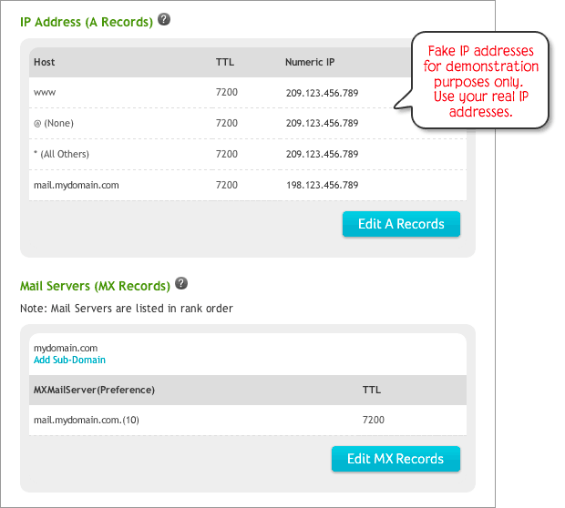
DNS Record Example

Slide 12
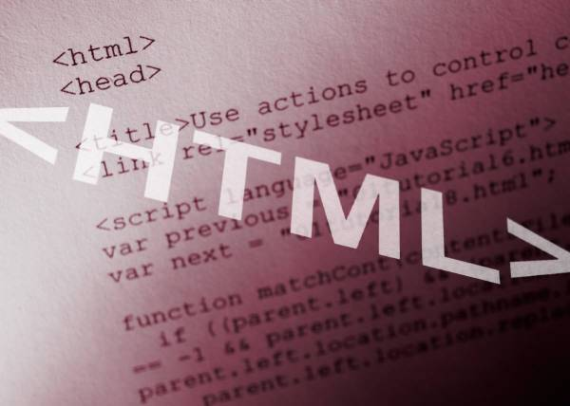
HTML
HyperText Markup Language (HTML)
The main markup language for displaying web pages

Slide 13
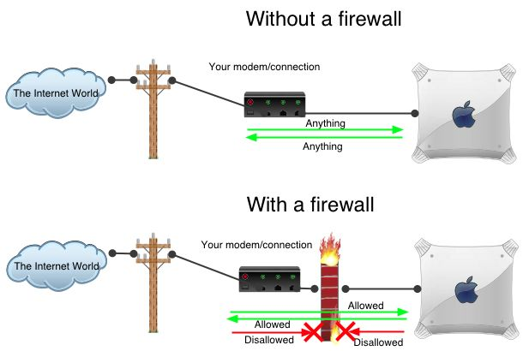
Firewall

Slide 14
HTML5 & JavaScript

Slide 15
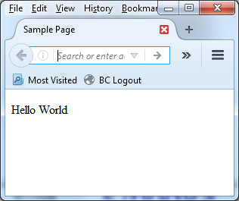
HTML Code
<!DOCTYPE html>
<html lang="en">
<head>
<meta charset="utf-8"> <title>Sample Page</title>
</head>
<body>
<p>Hello World</p>
</body>
</html>

Slide 16
<!DOCTYPE html>
The <!DOCTYPE> declaration is not an HTML tag; it is an instruction to the web browser about what version of HTML the page is written in.
In HTML5 there is only one type of declaration
<!DOCTYPE html>

Slide 17
<head>
The <head> element is a container for all the head elements.
The <head> element can include a title for the document, scripts, styles, meta information, and more.

Slide 18
<meta charset="utf-8">
UTF-8 is a compromise character encoding that can be as compact as ASCII (if the file is just plain English text) but can also contain any unicode characters (with some increase in file size). UTF stands for Unicode Transformation Format. The '8' means it uses 8-bit blocks to represent a character.

Slide 19
<body>
The <body> tag defines the document's body.
The <body> element contains all the contents of an HTML document, such as text, hyperlinks, images, tables, lists, etc.

Slide 20
<p>
The <p> tag defines a paragraph.

Slide 21
Drawing on the screen
We will be using a Canvas to draw to the screen.

Slide 22
Canvas for a game
<!DOCTYPE html>
<html lang="en">
<head>
<meta charset="utf-8">
<title>Canvas Example</title>
</head>
<body>
<div id="gameArea">
<canvas id="mycanvas" width="800“ height="600"></canvas>
</div>
</body>
</html>

Slide 23
<div>
The <div> tag defines a division or a section in an HTML document.
HTML id Attribute:
The id attribute specifies a unique id for an HTML element (the value must be unique within the HTML document).
JavaScript (via the HTML DOM) is used to manipulate the element with the specific id.

Slide 24
<canvas>
The <canvas> tag is used to draw graphics, on the fly, via scripting (usually JavaScript).
The <canvas> tag is only a container for graphics, you must use a script to actually draw the graphics.
HTML id Attribute:
The id attribute specifies a unique id for an HTML element (the value must be unique within the HTML document).
JavaScript (via the HTML DOM) is used to manipulate the element with the specific id.

Slide 25
The HTML DOM (Document Object Model)
The easiest way to find an HTML element in the DOM, is by using the element id.
This example finds the element with id="intro":
var myElement = document.getElementById("intro")

Slide 26
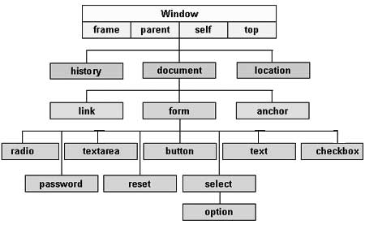
DOM

Slide 27
Drawing to the screen
<!DOCTYPE html>
<html lang="en">
<head>
<meta charset="utf-8">
<title>Canvas Example</title>
<script>
function changeCanvasColor () {
// Locate the element "mycanvas" in the document.
var canvas = document.getElementById("mycanvas");
var context = canvas.getContext("2d");
context.fillStyle = "cyan";
context.fillRect(0, 0, canvas.width, canvas.height);
}
// Once the HTML document has finished loading and has been
// parsed, call the changeCanvasColor function.
document.addEventListener('DOMContentLoaded',changeCanvasColor);
</script>
</head>
<body>
<div id="gameArea">
<canvas id="mycanvas" width="800" height="600"></canvas>
</div>
</body>
</html>

Slide 28
Events
HTML Events
An HTML event can be something the browser does, or something a user does.
JavaScript lets you execute code when events are detected.
HTML allows event handler attributes, with JavaScript code, to be added to HTML elements.

Slide 29
DOMContentLoaded
The DOMContentLoaded event is fired when the initial HTML document has been completely loaded and parsed, without waiting for stylesheets, images, and subframes to finish loading. A very different event load should be used only to detect a fully-loaded page. It is an incredibly popular mistake to use load where DOMContentLoaded would be much more appropriate, so be cautious.

Slide 30
EventListener
The addEventListener() method attaches an event handler to the specified element. In this example were are working with the document. When the HTML document is finished loading it will calle the function changeCanvasColor.
document.addEventListener('DOMContentLoaded',changeCanvasColor);

Slide 31
Getting the canvas
var canvas = document.getElementById("mycanvas");
The getElementById() method returns the element that has the ID attribute with the specified value.
This method is one of the most common methods in the HTML DOM, and is used almost every time you want to manipulate, or get info from, an element on your document.
Returns null if no elements with the specified ID exists.
An ID should be unique within a page. However, if more than one element with the specified ID exists, the getElementById() method returns the first element in the source code.

Slide 32
Canvas Context
The <canvas> element has no drawing abilities of its own (it is only a container for graphics) - you must use a script to actually draw the graphics.
The getContext() method returns an object that provides methods and properties for drawing on the canvas.
Currently only a 2d context is available for HTML5.

Slide 33
Drawing on the cavas
context.fillStyle = "cyan";
context.fillRect(0, 0, canvas.width, canvas.height);
Parameter | Description
x | The x-coordinate of the upper-left corner of the rectangle
y | The y-coordinate of the upper-left corner of the rectangle
width | The width of the rectangle, in pixels
height | The height of the rectangle, in pixels

Slide 34
Events
http://developer.mozilla.org/en-US/docs/Web/Events
http://www.w3schools.com/js/js_events.asp

